Slide 1


Sap ABAP on Hana &
s/4hana trainings
Anubhav Oberoy
Day – 2

Slide 2

Agenda – Day 2
New ABAP Syntax
Inline data declaration
Dynamic memory references
SQL Statement with escaping of host variables
SQL Enhancement
Introduction to DML, DDL, DCL, DQL.
Describe EPM Data Model
ABAP connect to HANA
Understanding HANA Folder Structure
Elaborating Design Time Object
Describing HANA Basics
---Break---
Showing Migration to SAP HANA as well as S/4 HANA
Describing Any Database Migration to HANA Database
ATC ( ABAP Test Cockpit ) v/s SCI ( SAP Code Inspector )
S/4HANA Code Conversion

Slide 3
New ABAP Syntax
We have now option to mark host variables in the select query – Escaping of host variable.
01
Now we can use comma separated
fields.
01
We can use Inline data declaration data() , String Expression.
We can use literals inside of sql queries & Arithmetic Operations.
.
02
02
SQL ENHANCHMENT
We can Create object & Value/Constructor Expression.
NEW ABAP SYNTAX
03
We have new SQL functions to perform logic.
03
We use Corresponding # & Table Expression.
04
Case Expression can be added.
04

Slide 4

SQL Enhancement
With the introduction of NW AS ABAP 740 SPS5, the New enhanced extended Open SQL was introduced. The new enhanced open sql has some good features such introduction of aggregate functions, right outer join, casting, etc. making it a starting step for Code-Push down paradigm.
Exercise 1
Learn New ABAP Syntax Code

Slide 5
Describe EPM Data Model
Real-time like demo data model which includes database tables, FMs, classes, Scenarios for training purpose and very much similar to real-life.
Products
Texts
Sales Order Header
Items
10 Laptops
3 HDD
5 Projectors
Purchase Order Header
Items
100 Laptops
300 HDD
50 Projectors
….
ITeIO
Electronics goods supplier (Amazon)
Customers (BP)
Suppliers (BP)
Invoice
Invoice Items
6 laptop
3 HDD
2 Projector
Stock
Invoice Line Item <= Sales Order Line item
6 laptop
3 HDD
2 Projector
Notes:
The sole purpose of an R/3 system is to provide a suite of tightly integrated, large-scale business applications. R/3 comes prepackaged with the core business applications needed by most large corporations. These applications coexist in one homogenous environment. They are designed from the ground up to run using a single database and one (very large) set of tables.
Presentation: It is usually installed on a user's workstation. When started, the presentation server displays the R/3 menus within a window. This window is commonly known as the SAPGUI, or the user interface (or simply, the interface).
Basis : Basis is like an operating system for R/3. It sits between the ABAP/4 code and the computer's operating system. SAP likes to call it middleware because it sits in the middle, between ABAP/4 and the operating system. ABAP/4 cannot run directly on an operating system. It requires a set of programs (collectively called Basis) to load, interpret, and buffer its input and output. Basis provides the runtime environment for ABAP/4 programs.
Database: The database server is a set of executables that accept database requests from the application server. These requests are passed on to the RDBMS (Relation Database Management System). The RDBMS sends the data back to the database server, which then passes the information back to the application server. The application server in turn passes that information to your ABAP/4 program.

Slide 6

HANA Folder Structure
In HANA also, to develop any of the HANA development objects we need Package. A package is a storage location of HANA design time objects. Calculation views, attribute, analytic views, hdbdd, hdbcds, hdbsequence….
Why?
Group things
Transport → Delivery Unit via package, you cant move content from D->Q->P
Package provides a namespace to the runtime objects – ANUBHAV ----activate---→ pkg::anubhav
Package in HANA provide security to make sure who can develop inside that package.

Slide 7
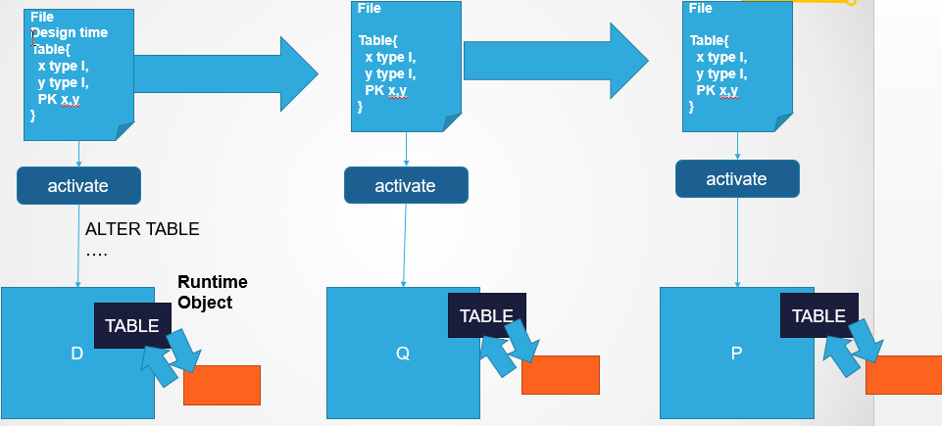
Design Time Object
The object can be project, package, schema, procedure, data models, etc. All the development objects built into SAP HANA are stored in a system called HANA Repository which is a storage system. The design-time environment's central component is SAP HANA repository which stores and manages all design-time objects.

Slide 8

HANA Basics
A Schema is a MANDATORY RUNTIME Object which existing in HANA DB. This is home of other runtime objects like tables, view, structure, procedure…..
All the schemas are stored under a node called catalog. There is a dedicated schema for ABAP system in HANA DB, which we can check in System Status.
-- Schema is mandatory object
-- When we create a user inside HANA DB, a schema with same name as user name will be created automatically
-- Schema also provides security at object level
-- When we develop objects in our local package in HANA and activate the runtime object will be created in our local schema

Slide 9

Break

Slide 10
Migration to HANA
A
B
C
ABAP
Business Suite
ABAP S/4HANA
ABAP
Non HANA
Any DB
HANA
HANA
Our company is migrating just the database
1. Basis – just like any other DB Migration, Data provisioning of all DB tables which are client independent. SUM
As an ABAP Developer, whether the custom code written by developers will work or not?

Slide 11
Any Database to HANA Database
Native SQL statements written in old DB will not work.
01
DB specific hints provided to system to indicate indexes.
02
When we read data from DB in non-sorted form and perform a Spurious Data.
03
Direct access to Pool and Cluster table.
04
Checks to DB specific Secondary index
05

Slide 12
ABAP Test Cockpit ( ATC )
ABAP Test Cockpit (ATC) is an SAP new tool for ABAP programs quality checking. ... The ABAP Test Cockpit is directly integrated into the ABAP workbench as well as in the ABAP Development Tools for Eclipse and allows checking code from just within the development environment the ABAP developer is used to.
Syntax Check & Standard SCI Check inc. slin
SAP HANA Checks (Functional DB)
ATC
SAP S/4 HANA Check
Security Check
ABAP Unit Test

Slide 13
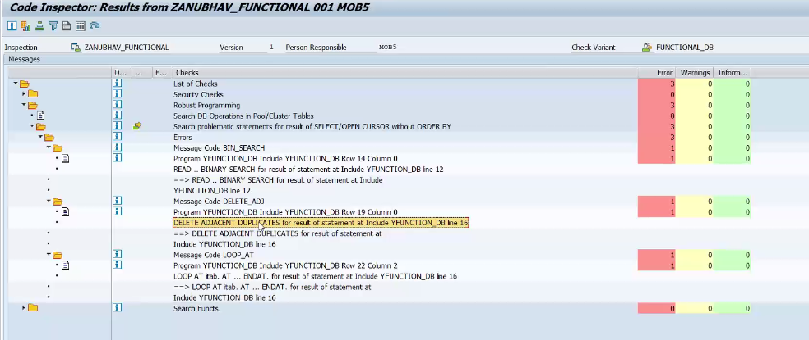
SAP Code Inspector ( SCI )
The Code Inspector is a tool for checking Repository objects. Using the Code Inspector, we can check individual objects or sets of objects for performance, security, syntax, and adherence to name conventions.

Slide 14
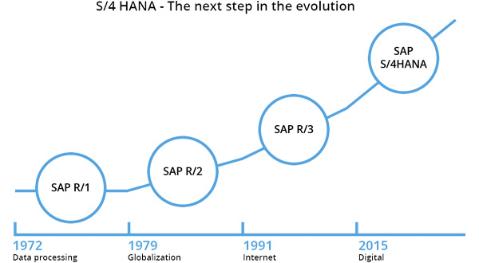
SAP ERP Evolution

Slide 15
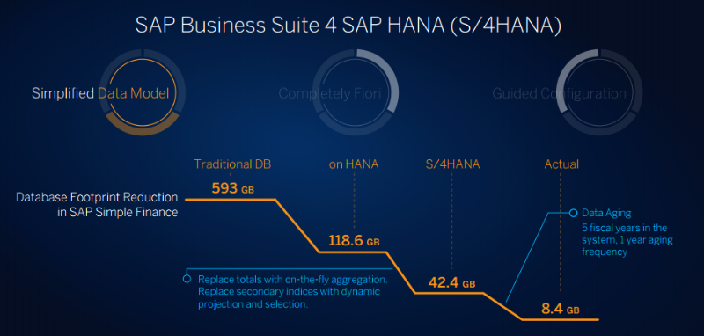
SAP ERP Evolution

Slide 16
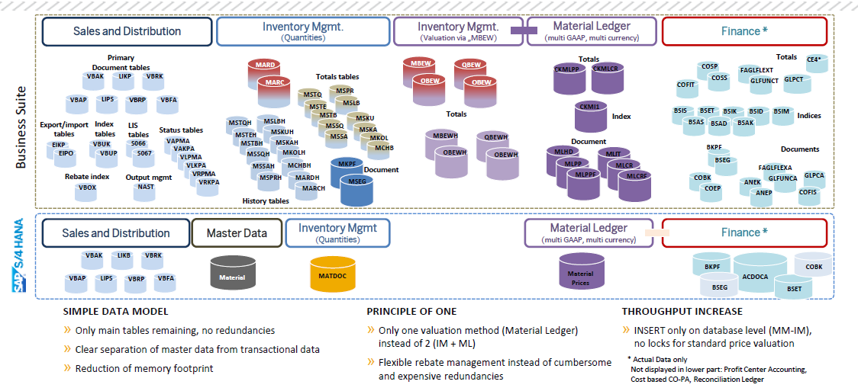
Architecture of SAP Material Table

Slide 17

What About My Custom Code

Slide 18
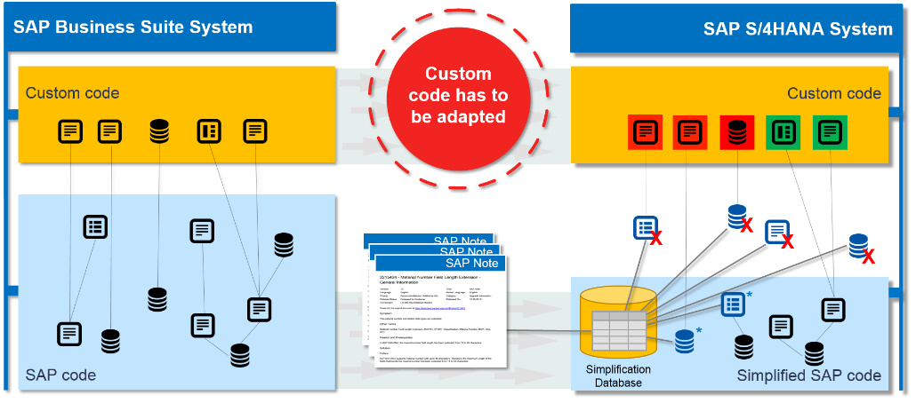
Custom Code Adaptation System

Slide 19
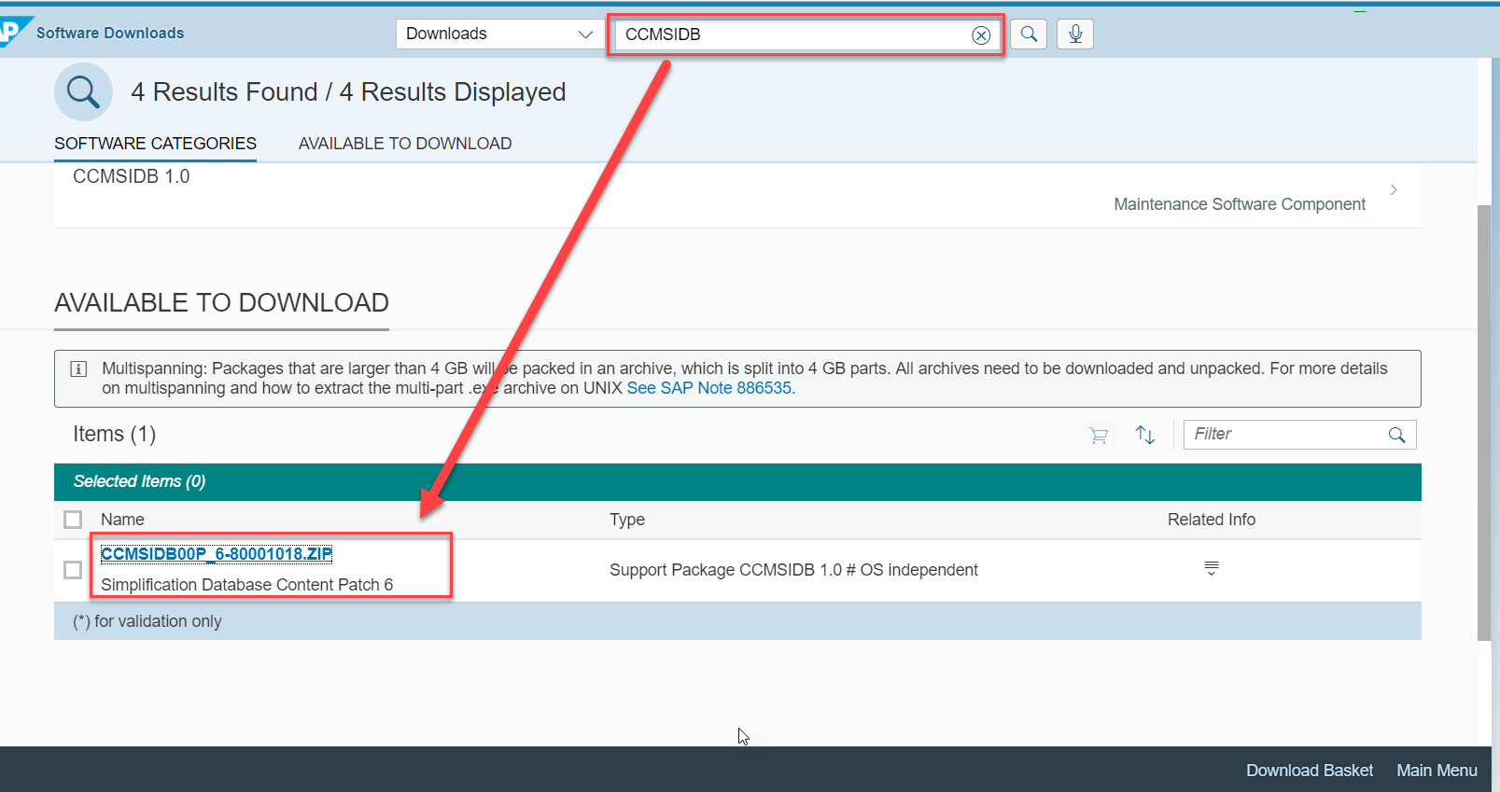
Adapting Custom Code in system

Slide 20
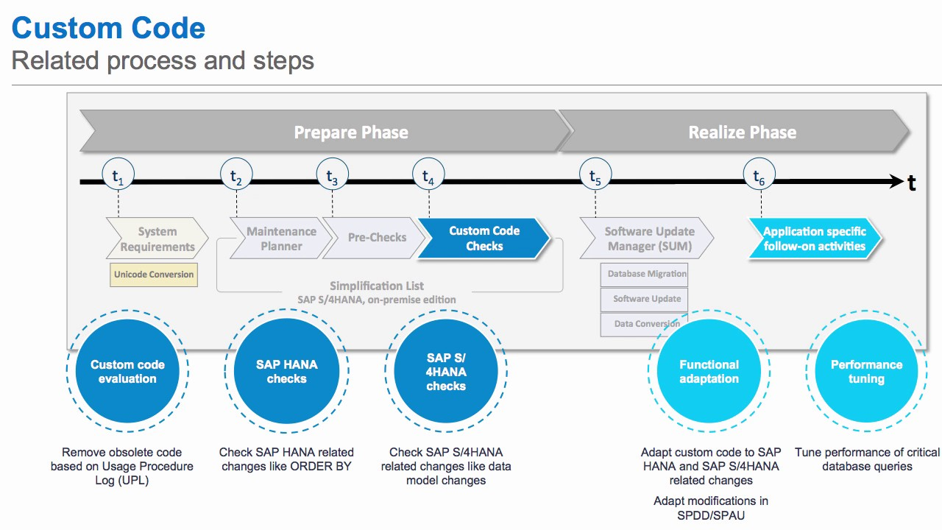
Custom Code Conversion Process
S4HANA_Readiness
https://blogs.sap.com/2016/02/02/sap-s4hana-custom-code-migration-worklist/

Slide 21

S/4 HANA CODE Conversion
SAP S/4HANA Readiness Check: is a tool designed to assist Customers with planning and preparation activities necessary to convert an SAP ECC system to SAP S/4HANA. Customers can execute to verify different aspects of an existing SAP ERP system.
Exercise 2
Custom Code Conversion

Slide 22

End of Day 2

Slide 23

Questions

Slide 24

Anubhav Oberoy

Slide 25


We’re committed to empower you to be
Most Desirable Resource
through powerful training solutions.
We build the workforce of the future.
250+
Corporate Clients
30,000+
Learners Trained
25000+
Learners Placed
FREE WEBINARS
Sign up for free webinars with industry experts every fortnight!
Enroll Now!
Contact us today!
https://anubhavtrainings.com/

Slide 26




More from AnubhavTrainings.com

